Slide 1
ChatterBotQA: The Question Answering ChatBot
Presented By:
Fernando Calderon, Prachi Khanna, Se’Lina Lasher

Slide 2

What is ChatterBotQA?
Natural Language Processing Defined: Natural language processing (NLP) refers to the branch of computer science—and more specifically, the branch of artificial intelligence or AI—concerned with giving computers the ability to understand text and spoken words in much the same way human beings can (What is Natural Language Processing, IBM).
ChatterBotQA Defined: ChatterBotQA is a Question Answering NLP System that Uses Context to Extract Answers
ChatterBotQA is Designed to Answer Questions in a Multitude of Languages Given a Context
Hi, My Name is Mary and I live in Berlin.
What is my name?
Mary
Donde Vivo?
Berlin
GitHub Repository: https://github.com/teslanando/AAI520_Final_Project_ChatBot

Slide 3
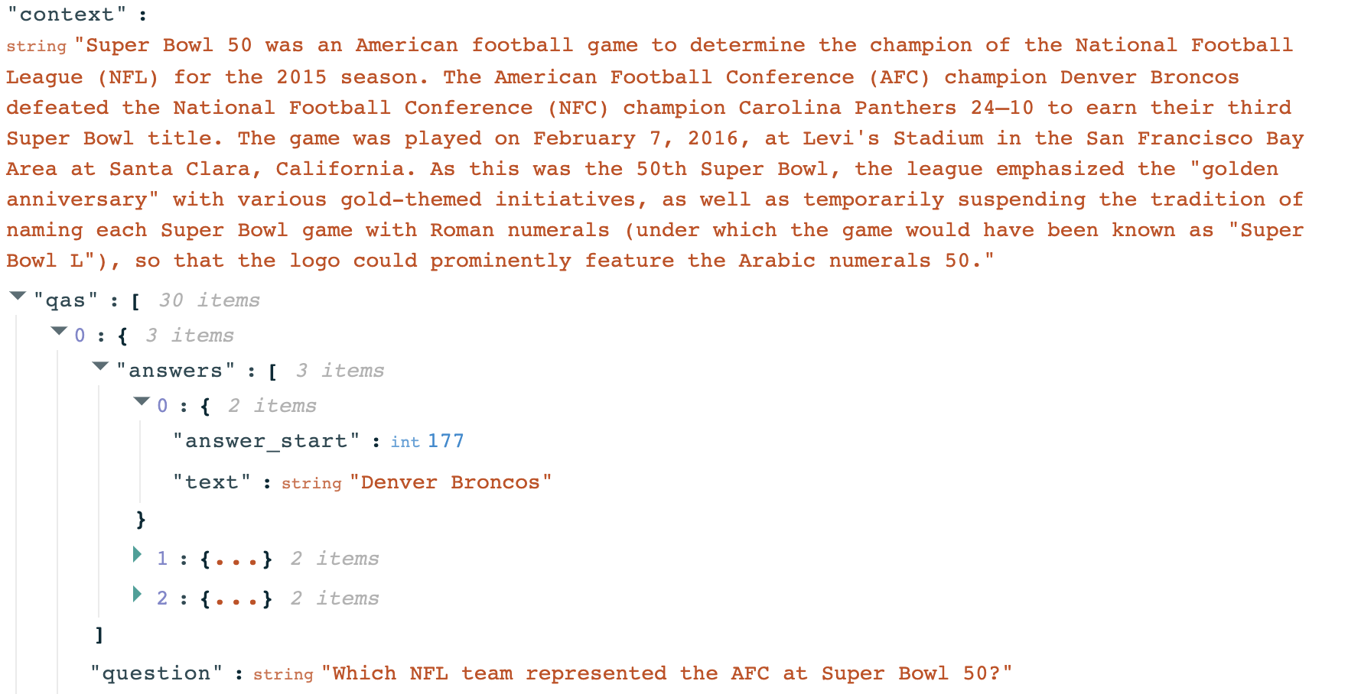
The Dataset
Stanford Question Answering Dataset (SQuAD):
SQuAD is a benchmark dataset for testing and advancing question-answering systems in NLP.
Contains diverse questions and corresponding answers from various crowdsourced Wikipedia articles, serving as a standard for evaluating NLP models.
Structured Data Inspires Chatbot Development:
The meticulously structured SQuAD dataset, where questions are linked to context paragraphs, served as a starting point for developing a QA chatbot based on extractions.

Slide 4
DistilBERT
A State-of-the-Art Pretrained Language Model:
DistilBERT stands at the forefront of natural language processing technology. Developed by Hugging Face, it represents the cutting edge of AI-driven language understanding.
A Compact and Efficient Iteration of BERT:
In the world of language models, DistilBERT is the streamlined, nimble version of its predecessor, BERT (Bidirectional Encoder Representations from Transformers). While retaining the powerful language understanding capabilities, it's engineered for efficiency, making it highly practical for various applications.
Fine-Tuned on the SQuAD Dataset for Question-Answering:
By training on the context, questions, and the precise starting and ending positions where answers are found, DistilBERT becomes an expert in the art of understanding questions and providing accurate responses directly from the text. This specialization makes it an ideal candidate for the task of question-answering, aligning its capabilities closely with ChatterBotQA’s purpose.
Notes:
DistilBERT is a cutting-edge language model developed by Hugging Face. It's an integral part of our Chatbot's capabilities and represents the latest advancements in natural language processing technology.
DistilBERT and BERT are both transformer models. These models are part of a revolutionary approach in natural language processing (NLP) known as the 'transformer' architecture. Transformers are designed to process and understand language in a highly parallel and efficient manner. They have the ability to capture long-range dependencies and relationships in text, making them exceptionally effective at various NLP tasks. DistilBERT is a streamlined version of BERT, maintaining the powerful transformer architecture while being more efficient and practical for a wide range of NLP applications.
Reduced Model Size: DistilBERT significantly reduces the number of parameters compared to BERT. This reduction in model size results in faster inference and lower memory requirements, making it computationally efficient.
Knowledge Distillation: DistilBERT is trained using a process called "knowledge distillation." During this process, it learns to mimic the behavior and knowledge of BERT while being smaller in size. This knowledge transfer allows DistilBERT to maintain a good level of performance while being more compact.
Practicality: The reduction in model size doesn't significantly compromise performance, making DistilBERT a practical choice for real-world applications. It is suitable for scenarios where computational resources may be limited.
Fast Inference: Due to its smaller size and streamlined architecture, DistilBERT can provide quicker responses, which is especially beneficial for real-time or latency-sensitive applications.
Broader Applicability: The efficiency of DistilBERT allows it to be deployed in a wider range of applications, where BERT's computational demands might be impractical.
While it retains the powerful language understanding capabilities of its predecessor, it's specifically engineered for efficiency. This means it's designed to work effectively and quickly in various applications, including our Chatbot.
DistilBERT's expertise doesn't end there. We've fine-tuned it on the SQuAD dataset, which is a structured collection of questions and answers. The fine-tuning process involved training DistilBERT to understand not only the questions but also the precise starting and ending positions of where answers are located in the text. This level of specialization makes DistilBERT an ideal candidate for the task of question-answering, which perfectly aligns with the purpose of our ChatterBotQA project. It's like the Chatbot's language expert, enabling it to provide accurate responses directly from the text.

Slide 5

ChatterBot’s Overall Architecture
‘Optuna’ HyperParameter Training Loop
SQuAD
Training Arguments
Fine Tuned QA Model
Trainer
PreTrained DistilBERT
Evaluation
Notes:
Precision: Precision measures the accuracy of the model's answers. It calculates the ratio of the true positive answers (correctly identified answers) to the total number of answers provided by the model. A higher precision indicates that the model's answers are mostly accurate.
Precision = True Positives / (True Positives + False Positives)
Recall: Recall measures the model's ability to find all the relevant answers to a question. It calculates the ratio of true positive answers to the total number of correct answers available in the dataset. A higher recall indicates that the model can identify most of the correct answers.
Recall = True Positives / (True Positives + False Negatives)
The F1 score combines both precision and recall into a single metric, balancing the trade-off between them. It is computed using the following formula:

Slide 6

Demo
Link to the Model: https://huggingface.co/sglasher/ChatterBotQA
Notes:
Here we have a demo showing how to utilize our model. Our model makes use of a Multilingual DistilBERT model, and as you’ll see shortly, it has the ability to comprehend a question asked in Spanish and retrieve the answer from the text.
[PLAY DEMO]
While our model demonstrates impressive capabilities in extracting text-based answers, it's important to note that it's not flawless. One of the key reasons behind this is the fine-tuning process. Our model has been fine-tuned on a subset of the dataset, which means that it has learned to answer questions and understand context based on a limited portion of the available data.
The quality and coverage of the fine-tuning data play a critical role in the model's performance. Fine-tuning on a larger and more diverse dataset could potentially enhance its accuracy and coverage, enabling it to provide even more precise responses to a broader range of questions.

Slide 7
The Results
Accuracy: The model achieved an accuracy of approximately 49.5%. Accuracy represents the proportion of correctly predicted answers out of the total predictions, providing a general measure of the model's correctness.
Precision (Weighted Average): The model demonstrated a weighted average precision of approximately 49.91%. Precision reflects the proportion of true positive predictions among all positive predictions, giving an indication of the model's ability to avoid false positives.
Recall (Weighted Average): The model exhibited a weighted average recall of about 49.5%. Recall signifies the proportion of true positive predictions among all actual positives, indicating the model's ability to capture all relevant instances.
F1 Score (Weighted Average): The model obtained a weighted average F1 score of approximately 48.85%. The F1 score is a balanced metric considering both precision and recall, providing a measure of overall model performance.

Slide 8
Findings and Feedback
Multilingual Functionality Enhancement:
The ChatBot was designed with multilingual functionality, but primarily trained on English data.
Consider sourcing Question Answer-based datasets in various languages to improve multilingual performance.
Enhancing proficiency in understanding and responding to questions in different languages is key.
Evolution into a Conversational ChatBot:
While excelling as a context-based Question Answering system, there's an opportunity to expand its capabilities.
Transformation into a comprehensive conversational ChatBot allows dynamic, interactive dialogues.
It can engage in sustained conversations, offer explanations, and maintain context, enriching user interactions and experiences.
Precision and Recall Improvement:
While the ChatBot can retrieve answers in most cases, there's room for enhancing precision.
Streamlining the answer extraction process will lead to more accurate and concise responses, thereby improving user satisfaction.

Slide 9
Individual Contributions
Fernando:
Contributor to presentation and report.
GitHub repository owner and administrator.
Contributed to the code for getting metrics to measure our model performance.
Prachi:
Data analysis and preprocessing
Training and evaluate chatbot using DialoGPT. Compare results of DialoGPT and DistilBERT (Team decided to choose BERT due to better performance) .
Drafted Project Report
Contributor to presentation
Se’Lina:
Preprocessed and Trained w/ HyperParameter Tuning and Deployed the Model
Acted as an Editor for the Presentation and Report
Debugged the Final Testing Metrics
Team Representative

